Slide 1
ERCOT Market Data Processing Improvements
Stephen Xu & Pranil Walke
07/26/2023

Slide 2
Moving away from legacy excel based tool to new automated Python based tools to aid daily Market Analysis Activities
Original version created in 2015
Transition from web scraping to API pull - 2021
“Planned” Retirement -2023
Evolution of ERCOT Market Data Downloads
Objective
Current State | Proposed State
Excel VBA Based | Python Based
Minimal documentation | Detailed Documentation
Non-existent logging | Detailed email capability to help with troubleshooting
Doesn’t work for many folders | Downloads all folders with available data
Slow: Takes up to an hour | Fast: Aim for 10x Speedup

Slide 3
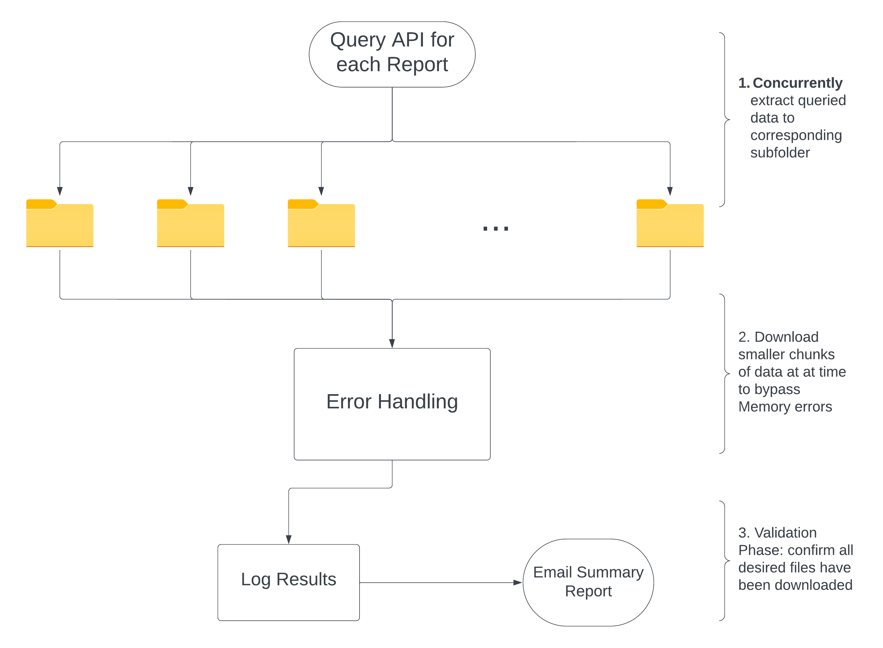
Concurrent Downloading , Advanced Error Handling, and Summary Report
Downloads over 100 reports, includes everything from 5-min data to planning reports

Slide 4
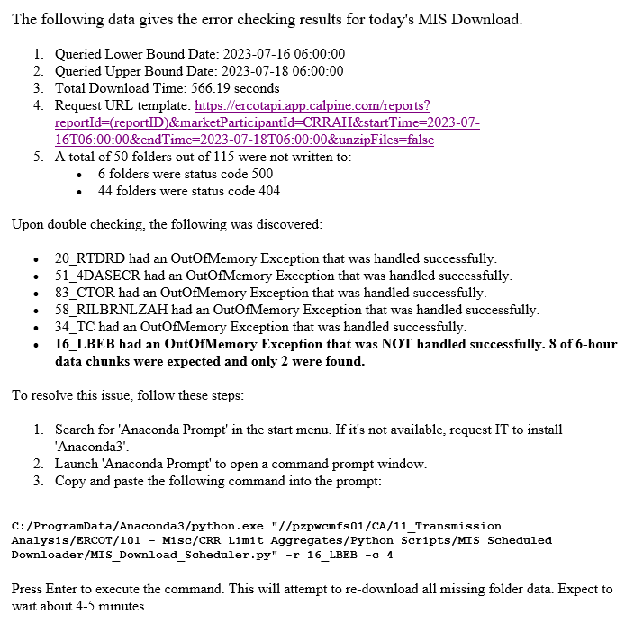
Detailed Summary Report, Tips For Troubleshooting
Automated to send immediately after the data gets downloaded (roughly 6:25 AM)
Detailed summary data
Provides Useful Troubleshooting Tips and Tricks
Offers an easy solution via the Command Line to manually download missing data

Slide 5
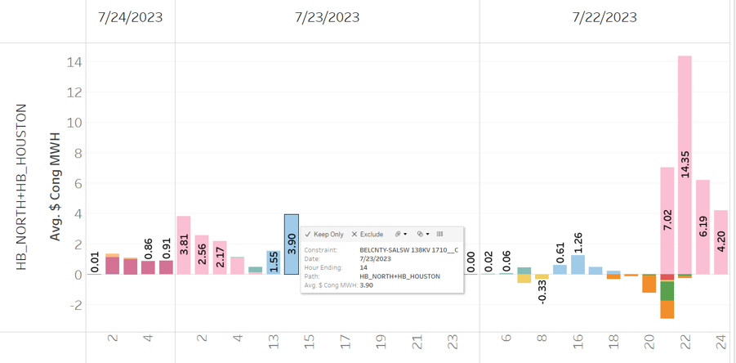
Automated Basis Analysis : Interactive Tableau Server Report
Typical Morning Meeting Question(s)
Will the basis from yesterday/last 2 days repeat today/tomorrow
Pricing PTP (spread bids)
Current Process | Changed
Manual Lookup Constraint Table | One Shot Fully Automated Python based scheduled task
Manual Lookup Shift Factor Table
Time Spent ~ 10 minutes | Time Spent : < 1 minute

Slide 6
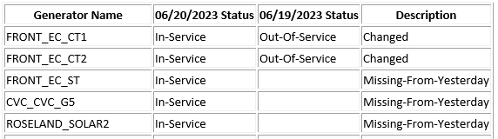
Automated generator availability report delivered via Email
ERCOT’s DA Market is a voluntary Market : Generator Availability is key to forecasting DA Market
Sample Report
Next Steps
Replace Generator Code by English Names
Add Size, Fuel Type
DA Network Zip Files published at 5am
Unzip, aggregate & compare last 2 days
Email summary of the results

Slide 7
Load doesn’t disappoint & Solar saves the day
New Load Record
Gen Outage driven Price spikes this summer
Major “unplanned” Gen Outages this summer
W A Parish U8,U5 & TH Wharton (NRG)
Deer Park (Calpine)
Year | ERCOT Peak Load (MW) | Solar Installed (MW)
2023 Summer | 82,592 | 13,027
Previous Peak 2022 | 79,828 | 9,139
Summer Stats Comparison (june & July)
Year | DALMP | Market HR | HSC (Gas) | # hrs with LMP at VOLL*
2023 | 73 | 32.5 | 2.2 | -
2022 | 120 | 18 | 7.1 | 3
2021 | 51 | 14 | 3.6 | -
2019 | 84 | 39 | 2.2 | 4
* Value of lost Load (VOLL) was reduced to 5000$/MWh starting 1/1/2022 from 9000$/MWh

Slide 8
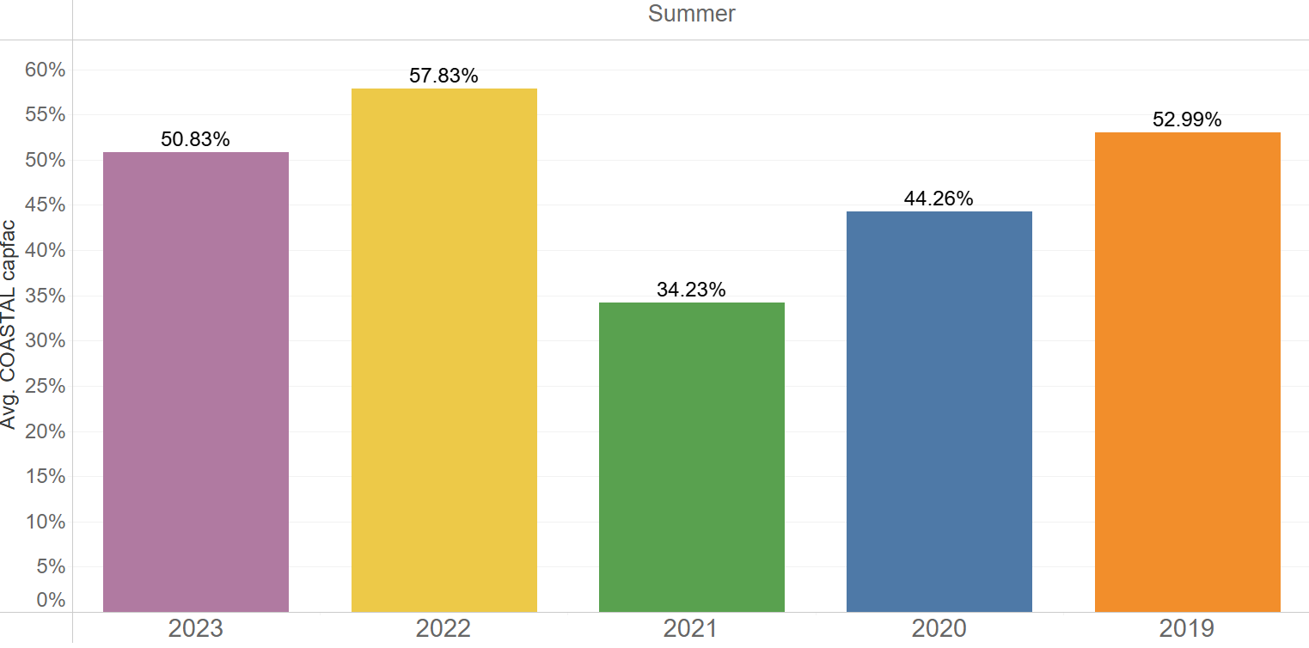
Bearish basis for Valley & Corpus assets driven largely by record wind generation along the Gulf Coast along with Frontera’s Return
Valley basis over the years
Strong coastal wind generation (HE15-20)
Average Summer Valley Basis ($/MWH) , Coastal Wind Installs (MW) & Frontera
Year | HE15-20 | Peak | Installed Wind (MW) | Frontera’s Contribution
2023 | -10 | -5 | 5,131 | 540
2022 | -22 | -12 | 5,131 | -
2021 | 2.16 | 1.06 | 4,930 | -
2019 | -2.15 | -1.52 | 3,203 | -

